Slide 1

Automotive Batteries
Chapter 29

Slide 2
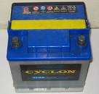
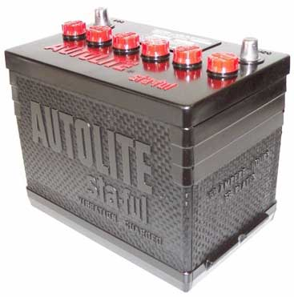
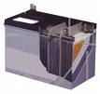
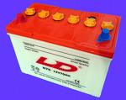
Basic Battery Principles
Batteries only store power,
they do not create it.
Batteries provide power for starting.
Batteries supply power when demand is greater that alternator output.
Batteries stabilize system voltage.

Slide 3
Basic Battery Terms
Battery - A device that stores electricity
Battery Cell - Consists of Negative & Positive plates
Battery Cycling - Repeated charging and discharging events
Battery Plates - Are made of lead and lead oxide
Charging - Current flowing into the battery from the charging system
Discharging - Current flowing out of the battery

Slide 4
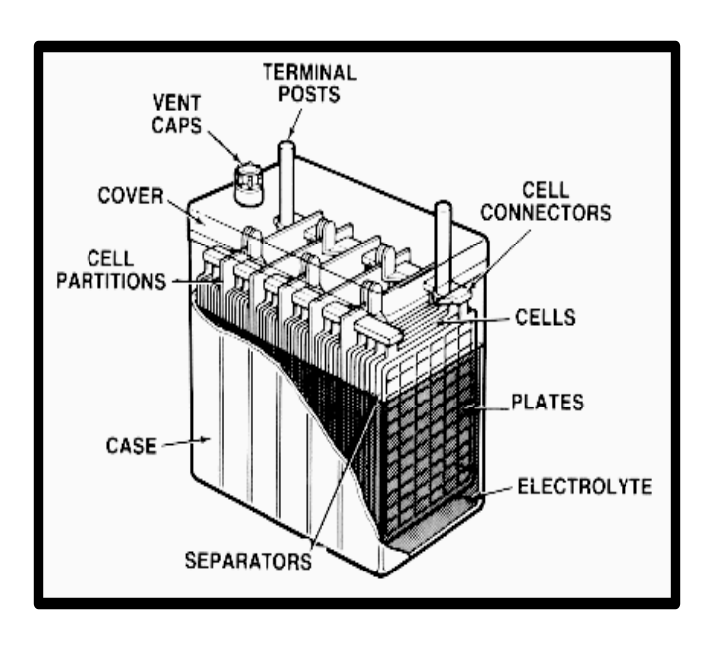
Basic Battery Terms
Electrolyte is a mixture of sulfuric acid and water. Anytime water is needed distilled water should be used.

Slide 5
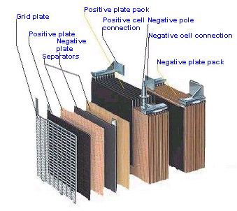
Battery Construction
A battery cell is made up of positive plates, negative plates, straps, and separators. Each cell supplies 2.10 volts DC

Slide 6
Battery Construction
The battery case is made of high-quality plastic, which holds the elements and electrolyte.

Slide 7
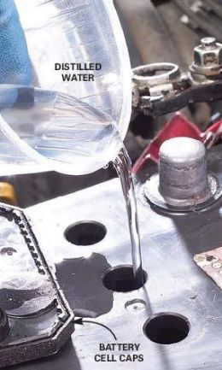
Battery Construction
Distilled water is used in batteries because it dose not contain impurities found in tap water.

Slide 8
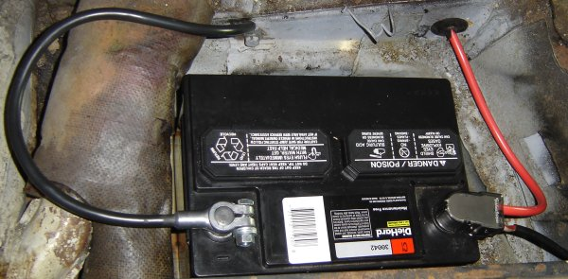
Battery Cables
The battery positive cable is normally a large red cable connected to the battery.

Slide 9
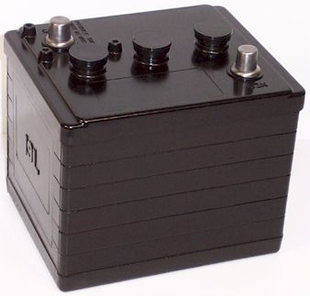
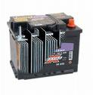
Battery Configurations
Batteries come in different voltages for different applications (# of cells x 2.1Volts)
6 Volt
3 cells
8 Volt
4 cells
12 Volt
6 cells
Actually 6.3 volts old cars and tractors
Actually 8.4 volts golf carts and floor machines
Actually 12.6 volts modern vehicles

Slide 10

Electrolyte
Battery electrolyte is a mixture of
25% sulfuric acid and distilled water.

Slide 11
Battery Products
An automotive battery produces:
Voltage
Direct Current
Hydrogen gas

Slide 12


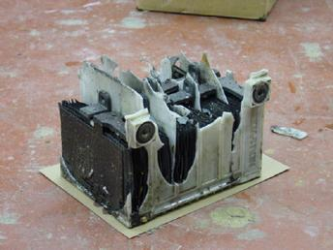
CAUTION!
Hydrogen gas is EXPLOSIVE!

Slide 13
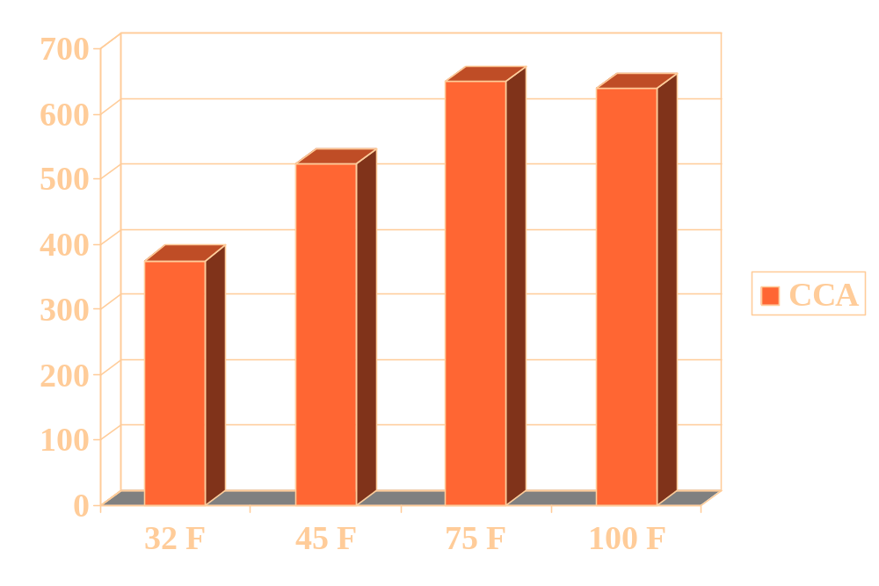
Temperature
As battery temperature drops, battery power is reduced

Slide 14
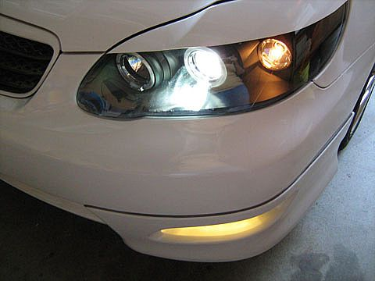
Parasitic Load
A parasitic load is any circuit current draw present when all electrical devices are shut off

Slide 15
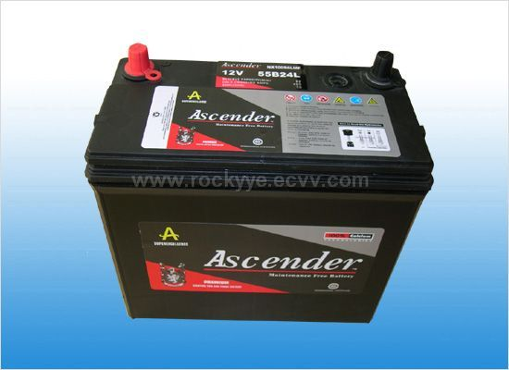
Maintenance Free Battery
A maintenance free battery does not have removable filler caps, it is sealed.

Slide 16
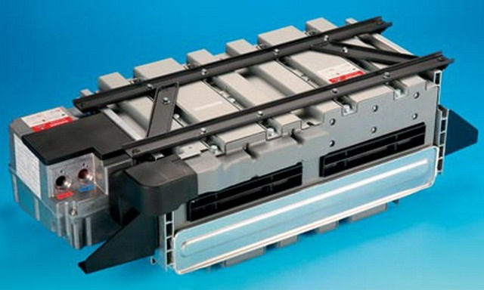
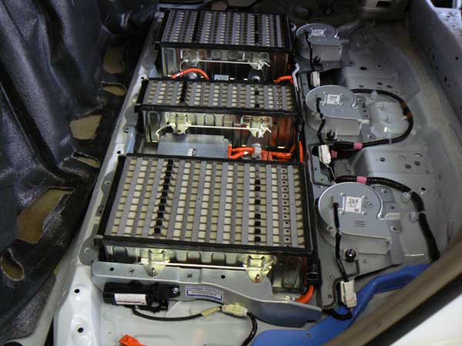
Modern Vehicles
Most modern vehicles use a 12.6 volt batteries
Hybrid vehicles use 144-270 volt batteries!
Porsche Cayenne
Toyota Highlander

Slide 17
Last Two Questions?
Look back through the power point to find your missing answers!

Slide 18
Want Additional Information?
Visit the web site below
Car Battery Myths & Facts

Slide 19
THE END

